Slide 1
Exploring Plain Vision Transformer Backbones for Object Detection
2022 Mar 30
鄧仲恩
NTUST GAMELab

Slide 2
Outline
Introduction
Related Work
Method
Experiments
Conclusion
NTUST GAMELab

Slide 3
Introduction
NTUST GAMELab

Slide 4
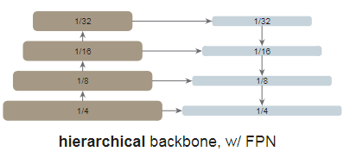
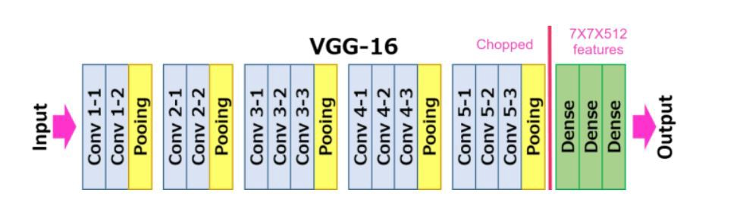
Introduction – Detection CNN base
Backbones
Neck
Head
VGG
ResNet
DarkNet
Region Proposal Networks (RPN)
Region-of-Interest (RoI)
Feature Pyramid Networks (FPN)
NTUST GAMELab
Notes:
ROI Pooling 統一anchor box 的尺度

Slide 5
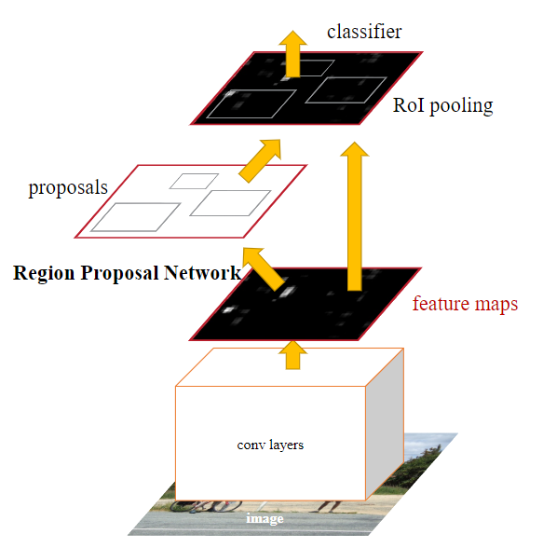
Introduction – Detection CNN base
NTUST GAMELab

Slide 6
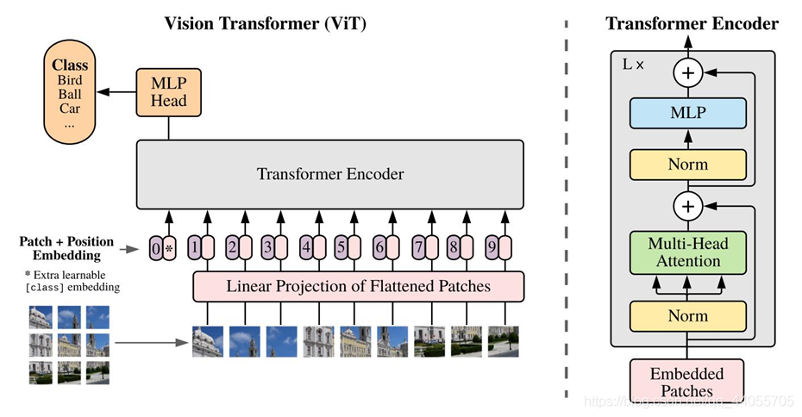
Introduction – Vision Transformers
Vision Transformers
Swin Transformers
NTUST GAMELab
Notes:
non-hierarchical
如何將Vit結合FPN

Slide 7
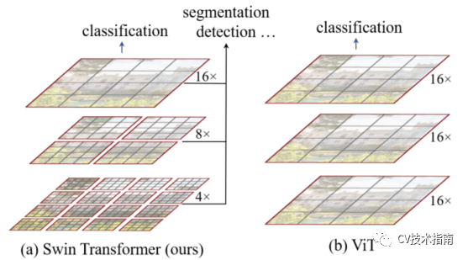
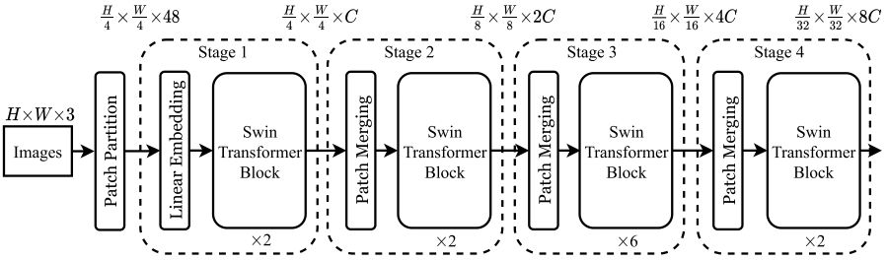
Introduction – Swin
NTUST GAMELab

Slide 8
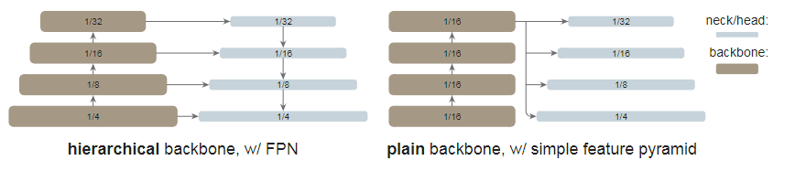
Introduction – Target
Use plain, non-hierarchical backbones. (Vision Transformers )
Independence of upstream vs. downstream tasks.
Use a simple feature pyramid.
Use Masked Autoencoder (MAE) pretraining.
Compete with the hierarchical-backbone detectors. (Swin, MViT)
NTUST GAMELab
Notes:
2. Like ConvNet-based research

Slide 9
Related Work
NTUST GAMELab

Slide 10
Related Work - Object detector backbones
Pioneered by the work of R-CNN.
SSD is the first works that leverage the hierarchical nature of the ConvNet backbones (VGG).
FPN pushes this direction further by using all stages of a hierarchical backbone, approached by lateral and top-down connections.
ViT is a powerful alternative to standard ConvNets for image classification. (Swin , MViT , PVT , PiT)
NTUST GAMELab
Notes:
4.作者認為以Vit去取代主幹是可以輕易實現的

Slide 11
Related Work - Plain-backbone detectors
ViT has inspired people to push the frontier of plain backbones for object detection.
UViT is presented as a single-scale Transformer for object detection.
1. depth, width, input resolution.
2. window attention strategy
NTUST GAMELab
Notes:
本文著重研究再不調整主幹的狀況下去分析結果. 並保持主幹與偵測頭的完整性

Slide 12
Related Work - Object detection methodologies
two-stage (R-CNN, Fast R-CNN, Faster R-CNN, SPP-Net) vs. one-stage (YOLO, SSD, RetinaNet)
anchor-based (Faster R-CNN) vs. anchor-free (FCOS, CenterNet, CornerNet)
region-based (R-CNN, Fast R-CNN, Faster R-CNN, SPP-Net) vs. query-based (DETR)
Plain vs. Hierarchical
NTUST GAMELab

Slide 13
Method
NTUST GAMELab

Slide 14
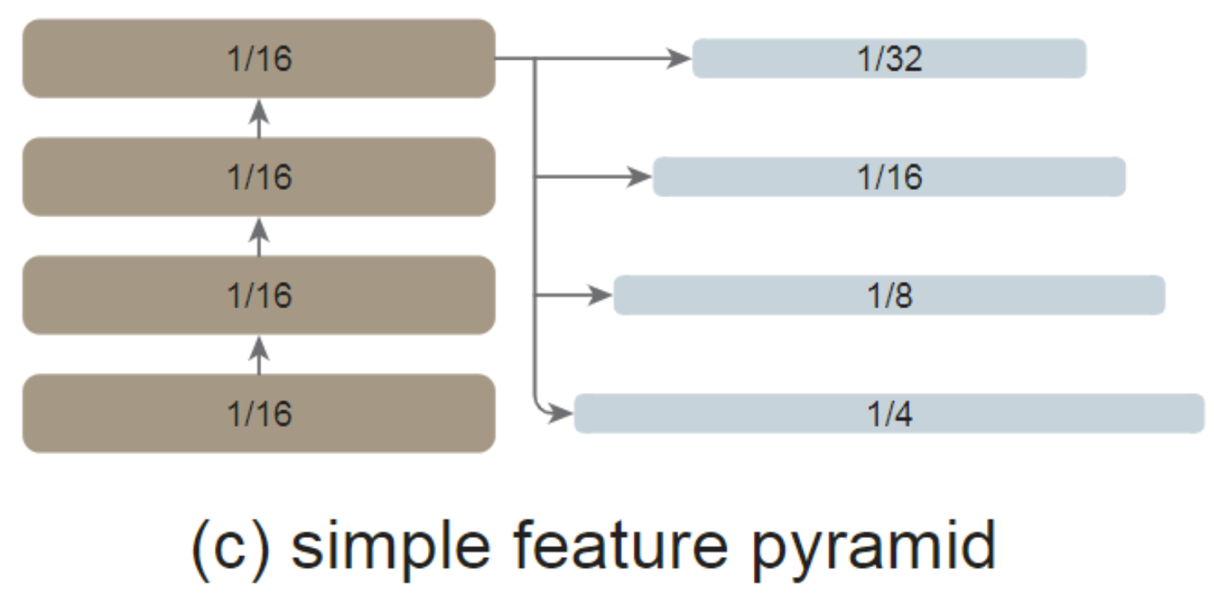
Method - Simple feature pyramid
Convolution
NTUST GAMELab
Notes:
想法來自SSD 但不一樣 只使用高層特徵
FPN通常由側邊連接 但使用ViT骨幹來說 以作者經驗是不必要的 因在ViT中已可保留大部分有必要的特偵
作者在實驗是否Simple feature pyramid 表現比較好

Slide 15
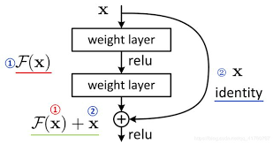

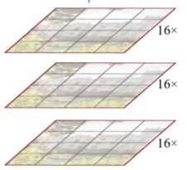
Method - Backbone adaptation
Global propagation
Convolutional propagation
propagation strategy
Simple feature pyramid
propagation strategy
Simple feature pyramid
propagation strategy
Simple feature pyramid
propagation strategy
Simple feature pyramid
NTUST GAMELab
Notes:
將網路分成4個subset 取最後一層執行傳播策略 就如 ViT-L就包含24-block
global self-attention
Convolutional 有殘差，值都預設成0，等價於 identity shortcut

Slide 16
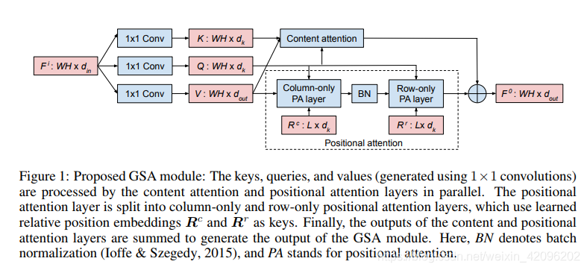
Method - Backbone adaptation
NTUST GAMELab

Slide 17
Method - Implementation
Pretraining backbones : ViT-B, ViT-L, ViT-H with MAE
Patch size : 16
Detector heads : Mask R-CNN or Cascade Mask R-CNN
Input image : 1024 X 1024
Augmented : large-scale jittering
Dataset : COCO train2017/val2017
Optimizer : AdamW
NTUST GAMELab
Notes:
global self-attention
Convolutional 有殘差，值都預設成0，等價於 identity shortcut

Slide 18
Experiments
NTUST GAMELab

Slide 19
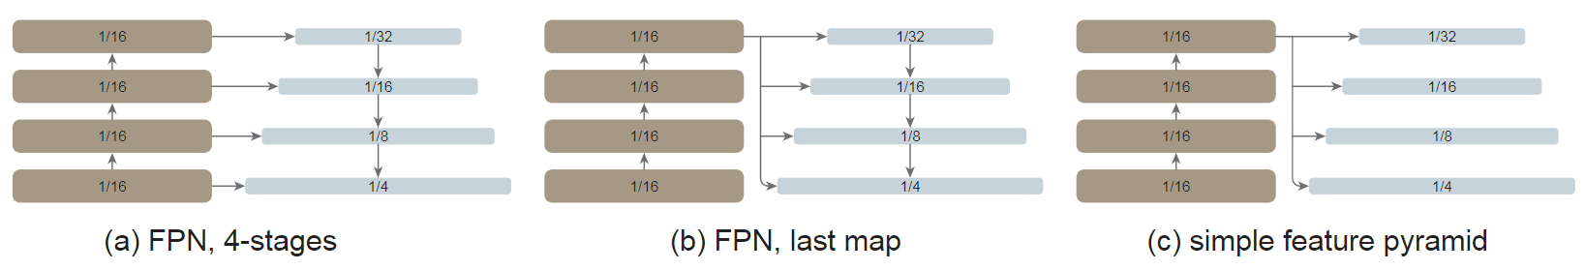
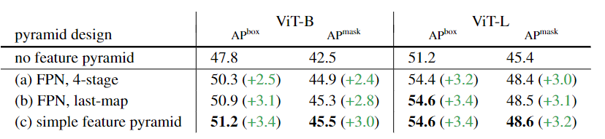
Experiments - Ablation Study and Analysis
NTUST GAMELab
Notes:
組件的對比實驗/性能分析
Both > base line 2.4 points 與FPN論文觀察是一至的
作者認為不需要 FPN 設計，簡單的特徵金字塔足以使ViT 主幹享受金字塔的好處。
第一次簡化結果
第二次簡化結果
一個簡單的特徵金字塔就足夠了

Slide 20
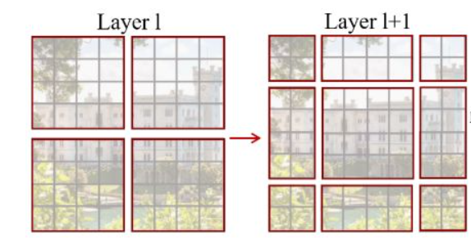
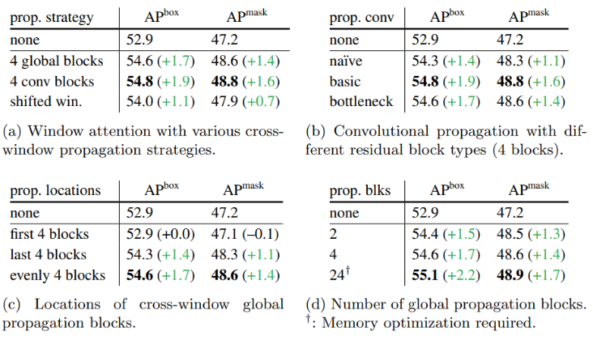
Experiments - Ablation Study and Analysis
A
B
Na ̈ıve : 3x3 conv
Basic : two 3×3 conv
Bottleneck : 1x1 -> 3x3 -> 1x1
NTUST GAMELab
Notes:
None 表示沒有傳播區塊 直接進入特偵金字塔
結論是不管怎樣的傳播區塊設計都比沒有傳播區塊好
A)Global self-attention
A)即使不用shifted windows, conv可以有更佳的結果
B)儘管捲機是局部的特偵抽取，但對於兩個窗口的連接已足以
C)都比baseline好。
C)均勻插入四個block 結果是好的
D)24層參數量會太多，導致momery與時間都大幅上升，不符合成本效益

Slide 21
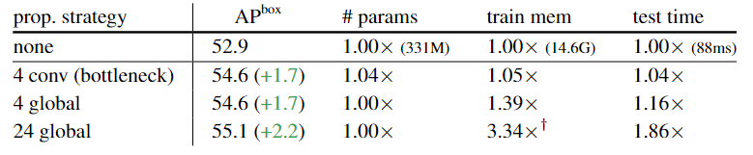
Experiments - Ablation Study and Analysis
NTUST GAMELab
Notes:
4 conv 只比 none 大4% 5% 4%
24global 問題

Slide 22
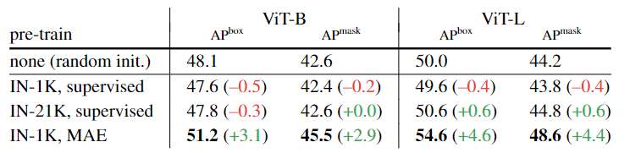
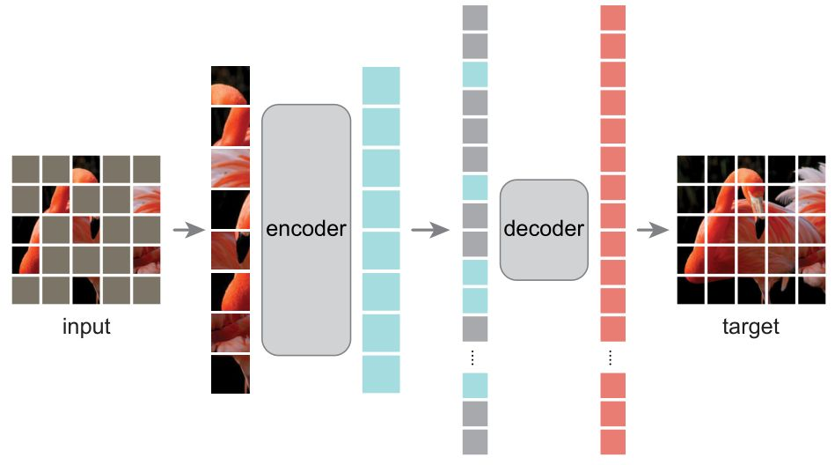
Experiments - Ablation Study and Analysis
NTUST GAMELab
Notes:
IN = ImageNet
MAE pretrain可用於緩解 overfitting的問題

Slide 23
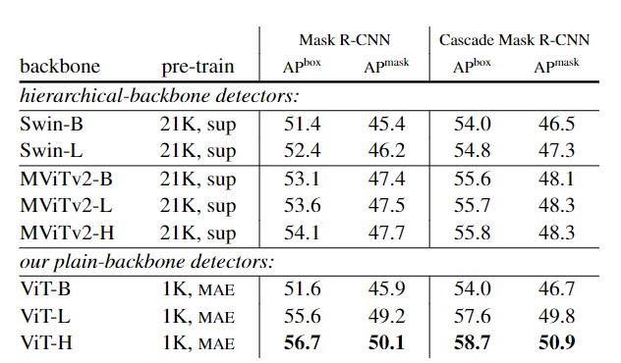
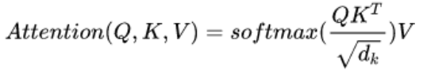

Experiments - Comparisons with Hierarchical Backbones
NTUST GAMELab
Notes:
relative position biases 加上約多AP 多一 point
plain-backbone detector+MAE 有最佳APbox 與 APmask

Slide 24
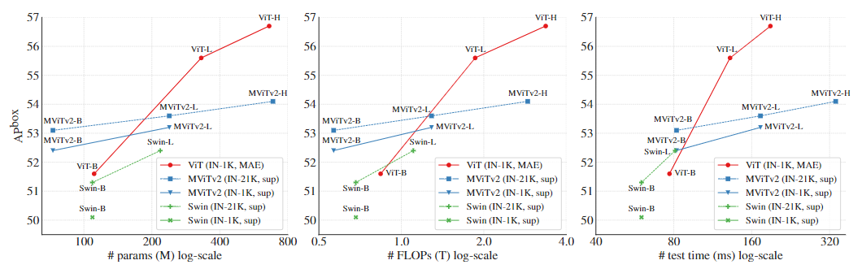
Experiments - Comparisons with Hierarchical Backbones
NTUST GAMELab

Slide 25
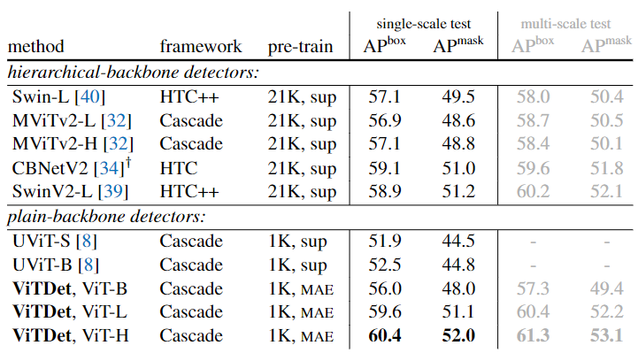
Experiments - Comparisons with Hierarchical Backbones
Comparisons on COCO
input size 1024->1080
adopt soft-nms
NTUST GAMELab
Notes:
UViT 也是plain-backbone detection method.

Slide 26
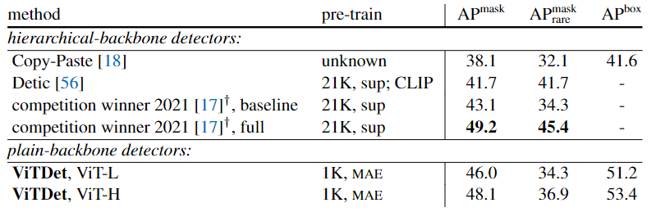
Experiments - Comparisons with Hierarchical Backbones
LVIS
1.1203 classes
2. long-tailed object distribution
Comparisons on LVIS
federated loss
repeat factor sampling
HTC+CBNetV2+2*Swim-L
NTUST GAMELab
Notes:
長尾分布 資料極度不平衡 <10
ViTDet呈現了具有競爭力的性能
2021 competition winner‘s 結合HTC 和 CBNetV2，結合了兩個 Swin-L 主幹

Slide 27
Conclusion
NTUST GAMELab

Slide 28
Conclusion
Plain-backbone detection is a promising research direction.
Decoupling pretraining from fine-tuning will generally benefit the community.
Plain-backbone detector has benefited from pretrained models from MAE.
We hope this methodology will also help bring the fields of computer vision and NLP closer.
NTUST GAMELab
Notes:
plain-backbone 檢測是一個很有前途的研究方向。 這種方法在很大程度上保持了通用主幹網和下游任務特定設計的獨立性。
我們希望將預訓練與微調分離是一種普遍有益於社區的方法。 例如，在自然語言處理中，通用預訓練極大地推動了該領域的發展，並一直支持各種下游任務。
在這項研究中，簡單骨幹檢測器可以適用MAE 預訓練模型訓練。
我們希望這種方法也有助於拉近計算機視覺和 NLP 領域的距離。

Slide 29
報告完畢 THE END
謝謝 Thank You
NTUST GAMELab

